Slide 1
CSE413 – Security of Information Systems 2020 PhD Furkan Gözükara, Toros University https://github.com/FurkanGozukara/Security-of-Information-Systems-CSE413-2020
Lecture 5
Risk Management
Business Continuity Management
Composed from Prof. Audun Jøsang, University of Oslo, Information Security 2018 Lectures
Source : https://www.uio.no/studier/emner/matnat/ifi/INF3510/v18/lectures/

Slide 2
What is risk?
ISO31000 Risk Management:
“Risk is the effect of uncertainty on objectives”
No distinction between positive and negative effects of uncertainty
This definition is too abstract for most people
Also says: “Risk is often expressed in terms of a combination of the consequences of an event (including changes in circumstances) and the associated likelihood of occurrence.”
Harris, CISSP 7th ed.:
“Risk is the likelihood of a threat agent taking advantage of a
vulnerability and the resulting business impact.” (Glossary p.1285)
ISO 27005 (Information Security Risk)
“Risk is the potential that a given threat will exploit vulnerabilities of assets and thereby cause harm to the organization.”

Slide 3
Abstract Risk Model (NSM)
Assets
General Risk
Threats Vulnerabilities
Models general risk in an abstract way
– The more assets you have, the more threats you are faced with,
and the more vulnerable you are, then the greater the risk.

Slide 4
Detailed risk model
Legend: has attribute contributes to
Threat agent
Threat agent motivation
Threat agent capacity
Threat scenario
Threat agent
strength
Vulnerability to
threat scenario
Each specific risk
results from a threat
scenario that can affect specific assets.
Motivation, capacity, vulnerability and impact determine the risk level for that specific risk
Likelihood/frequency of (threat scenario to cause) incident
Impact of incident on asset
Specific Risk

Slide 5
Many Risks
Multiple different threats (threat scenarios) can be identified
Each threat can potentially cause an incident
Each potential incident has a risk level
Multiple threats ⇒ Many risks
Threat 1
Incident 1
Risk 1
Threat 2
Incident 2
Risk 2
Threat 3
Incident 3
Risk 3

Slide 6
Practical risk model
Practical risk analysis typically considers two factors to determine the level of each risk
Likelihood / frequency of each type of incident
Impact on assets (loss) resulting from each type of incident
Threat scenario
Likelihood/frequency of (threat scenario to cause) incident
Impact of incident on asset
×
Risk level

Slide 7
Risk Management standards
ISO 27005 Information Security Risk Management
ISO 31000 Risk Management
NIST SP800-39 Managing Information Security Risk
NIST SP800-30 Guide for Conducting Risk Assessment
– formerly called “Risk Management Guide for
Information Technology Systems”

Slide 8
What is risk management?
“IS risk management analyses what can happen and what the possible consequences can be, before deciding what should be done and when, to reduce risk to an acceptable level.”
– ISO 27005
“Risk management consists of coordinated activities to direct and control an organization with regard to risk.”
– ISO31000 , ISO/IEC 27002

Slide 9
Risk management process
ISO 27005
Information security strategy
IS Risk Management
Organisation
Approach
Scope
Context Establishment
Risk identification
Risk estimation
Risk evaluation
Communication
• Risk criteria
Risk Assessment
N
Risk decision point 1: _{Y} Assessment satisfactory?
Risk reduction
Risk transfer
Risk retention
Risk avoidance
Communication
Risk Treatment Plan
N
Risk decision point 2: _{Y} Treatment satisfactory?
Accepted Residual Risk
Risk communication
Implement risk treatment plan

Slide 10
Risk assessment process
ISO 27005
Context establishment
Risk Assessment
Identification of assets
Identification of threats
Identification of existing controls
Identification of vulnerabilities
• Identification of consequences
Assess asset values and impacts
Risk identification
Risk analysis
Risk estimation
Assess incident likelihood/frequency
Determine/compute risk levels
Risk evaluation
Rank risks
Compare risks with criteria
Decide whether risk assessment is satisfactory

Slide 11
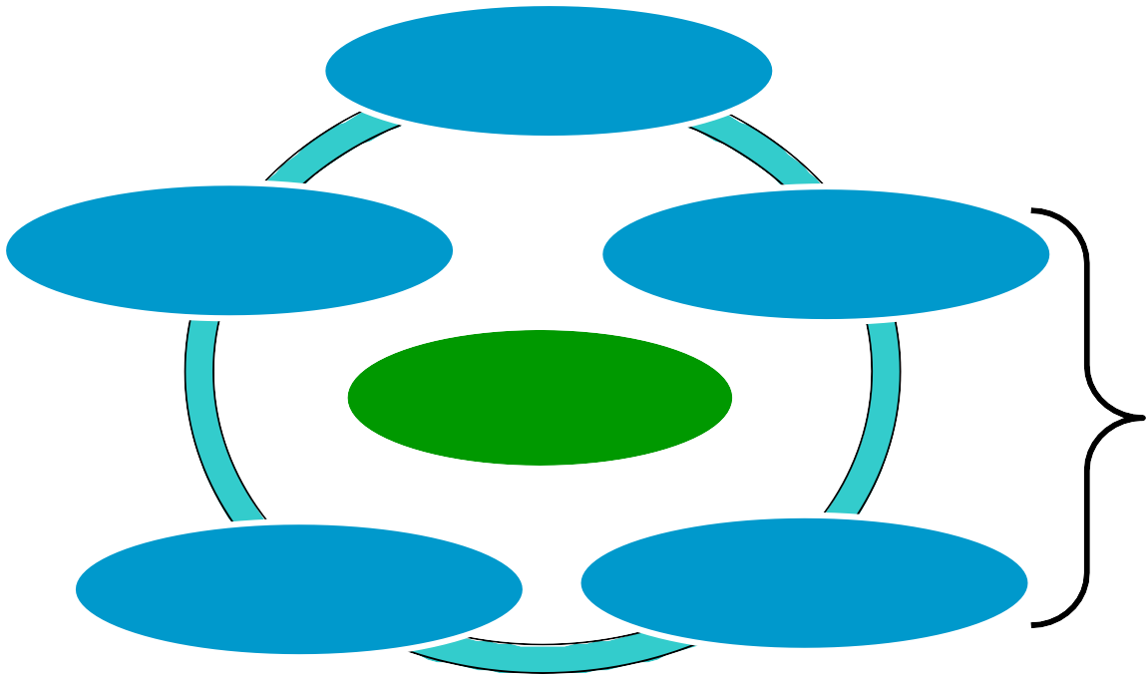
Risk Management – ISMS integration
Risk management is an essential element of Information security management system (ISMS)
Required to identify threats (what can go wrong)
Basis for selecting security controls
Tool for top management to understand organization’s risk exposure
Planning
Reporting
Risk Assessment
ISMS
Cycle
IS Risk
Management
Security Controls
Evaluation

Slide 12
Basis for assessing risk
Know the assets: identify, examine, and understand the information and systems currently in place
Know the enemy: identify, examine, and understand threats facing the organization
Know the losses your organisation can tolerate.
Know responsibility of each stakeholders within an
organization to manage risks that are encountered

Slide 13
Roles involved in risk management
Management, users, and information technology must all work together
Asset owners must participate in developing inventory lists
Users and experts must assist in identifying threats and
vulnerabilities, and in determining likelihoods
Risk management experts must guide stakeholders through the risk assessment process
Security experts must assist in selecting controls
Management must review risk management process and approve controls

Slide 14
Problems of measuring risk
Businesses normally wish to measure risk in money, but almost impossible to do this
Valuation of assets
Value of data, hard to assess
Value of goodwill and customer confidence, very vague
Likelihood of threats
Past events not always relevant for future probabilities
The nature of future attacks is unpredictable
The actions of future attackers are unpredictable
Measurement of benefit from security control
Problems with the difference of two approximate quantities
Estimation of past and present risk

Slide 15
Asset Valuation and Prioritization
Questions help develop criteria for asset valuation
Which information asset:
is most critical to organization’s success?
generates the most revenue/profitability?
would be most expensive to replace or protect?
would be the embarrassing or cause liability if revealed?
Prioritization
Create weighting for each category
Calculate relative importance of each asset
List the assets in order of importance using a weighted factor
analysis worksheet

Slide 16
Threat scenario identification
Realistic threat scenarios need to be described; unimportant threats can be ignored
Threat assessment:
Which threats present danger to assets?
Which threats represent the most danger to information?
How much would it cost to recover from attack?
Which threat are most expensive to prevent?
Threat assessment is important during system development
Used to discover and avoid vulnerabilities in software and systems.

Slide 17
Threat Scenario Modelling
Attacker-centric
Starts from attackers, evaluates their goals, and how they might achieve them through attack tree. Usually starts from entry points or attacker action.
System-centric (aka. SW-, design-, architecture-centric)
Starts from model of system, and attempts to follow model dynamics and logic, looking for types of attacks against each element of the model. This approach is e.g. used for threat modeling in Microsoft's Security Development Lifecycle.
Asset-centric
Starts from assets entrusted to a system, such as a collection of sensitive personal information, and attempts to identify how security breaches of CIA properties can happen.

Slide 18
Attacker-centric attack tree example
G₀: Attacker wants user
account data
G₁: SQL injection through web
G₂: Impersonate login
G₃: Attack user client with XSS (cross site script)
G₄: Get login Ids
G₅: Find passwords
Legend:
G₀: Main goal
AND (conjunctive)
all subgoals needed
OR (disjunctive)
any subgoal needed
Probability of attack success: p(G₀) = 1-(1-p(G₁))⋅(1-(p(G₄)p(G₅)))⋅(1-p(G₃))

Slide 19

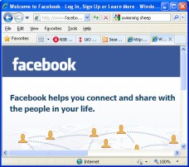

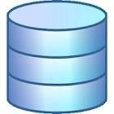
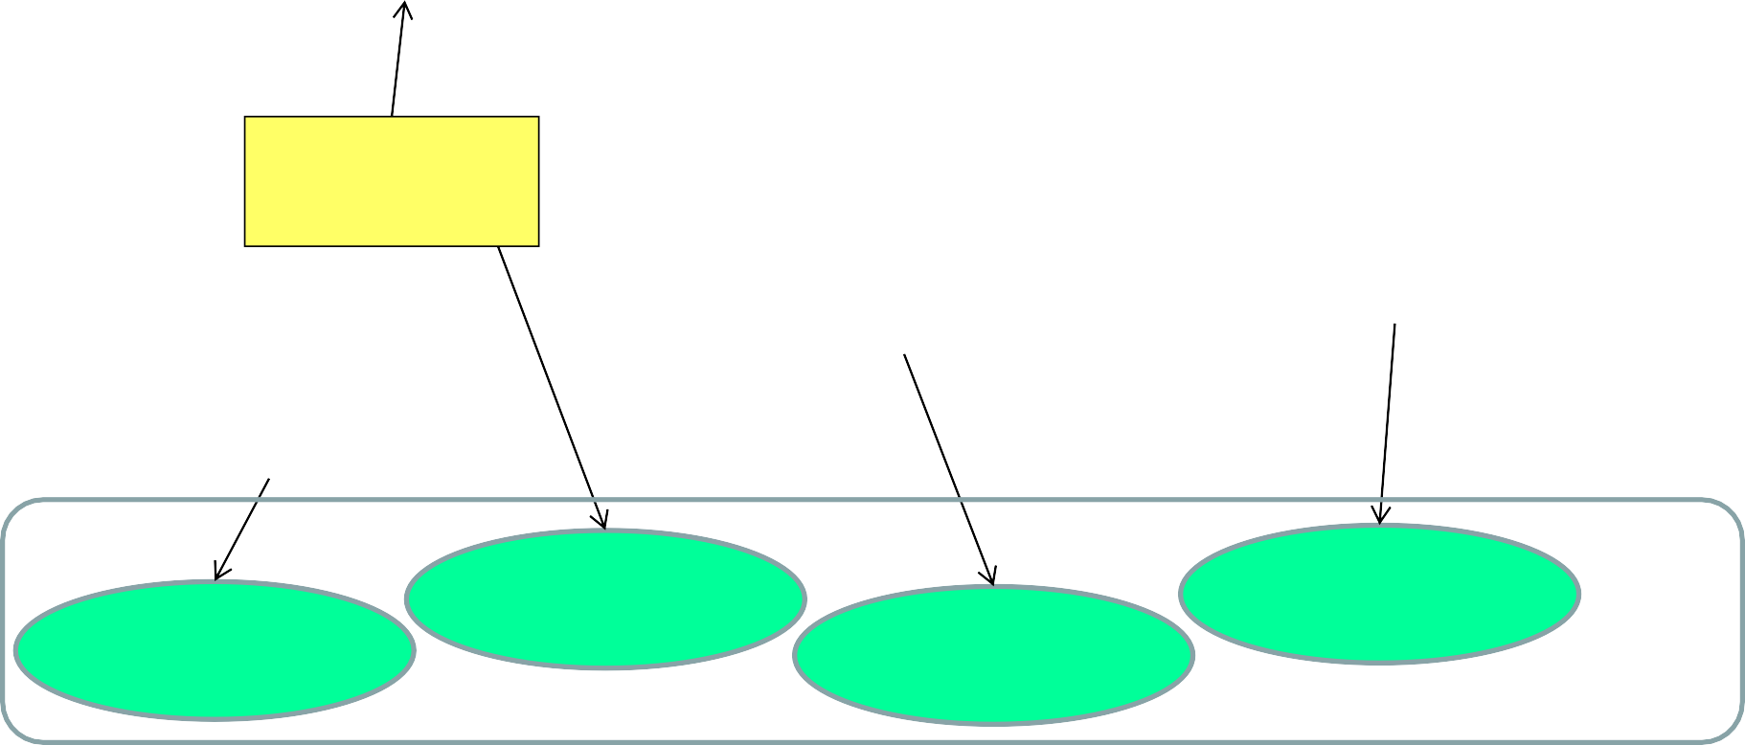
System-centric threat modelling example
Front end Web server
Back end app. logic
MySQL
database
Internet
Traffic
interception
SQL injection
User may not have logged off on shared computer
Unauthorized access
Implement encryption
Validate input
Implement timeout
Password policy
Controls

Slide 20

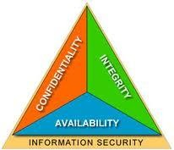
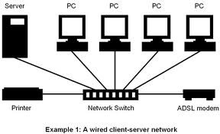



Asset-centric threat modelling example
Data CIA
HW and SW
Company reputation
Customer
base
Legal compliance
Penetration
of servers
Disclosure
of user data
DOS attack
Misuse of user data

Slide 21
Vulnerability Identification
Specific avenues threat agents can exploit to attack an information asset are called vulnerabilities
Examines how each threat could be perpetrated against the organization’s assets
Process works best when people with diverse backgrounds within organization work iteratively in a series of brainstorming sessions
At end of risk identification process, list of assets and their vulnerabilities is achieved
Vulnerabilities discovered during system development can be fixed and avoided in production system.

Slide 22
Identifying specific risks
Threats / incidents
Password compromise
SQL injection
Logical bomb in SW
Trojan infects clients
Cryptanalysis of cipher
Brute force attack
Social engineering
…..
Vulnerabilities
Weak passwords
Poor awareness
Asset impacts
Deleted files
Damaged files
Damaged reputation
Stolen files
- sensitivity levels 1,2,3
Intercepted traffic
False transaction
…
No input validation
Outdated antivirus
Weak ciphers
Short crypto keys
Poor usability
…
A valid combinations of threat, vulnerability and asset impact represents a single specific risk
All relevant specific risks should be identified

Slide 23
Estimating risk levels
Types of analysis
Qualitative
Uses descriptive scales. Example:
Impact level: Minor, moderate, major, catastrophic
Likelihood: Rare, unlikely, possible, likely, almost certain
Semi-quantitative
Qualitative scales assigned numerical values
Can be used in formulae for prioritization (with caution)
Quantitative
Use numerical values for both consequence (e.g. $$$) and likelihood (e.g. probability value)

Slide 24
Qualitative likelihood scale
Likelihood | Description
High | Is expected to occur in most conditions (1 or more times per year).
Medium | The event will probably happen in most conditions (every 2 years).
Low | The event should happen at some time (every 5 years).
Unlikely | The event could happen at some time (every 10 years).
Increasing Likelihood

Slide 25
Qualitative impact level scale
Impact | Description
Major | Major problems would occur and threaten the provision of important processes resulting in significant financial loss.
Moderate | Services would continue, but would need to be reviewed or changed.
Minor | Effectiveness of services would be threatened but dealt with.
Insignificant | Dealt with as a part of routine operations.
Level
Increasing Impact

Slide 26
Qualitative risk estimation - example
Qualitative risk levels: Add likelihood & impact level
Impact level
Risk level | (0) Insignificant | (1) Minor | (2) Moderate | (3) Major
(3) High | (3) M | (4) H | (5) VH | (6) E
(2) Medium | (2) L | (3) M | (4) H | (5) VH
(1) Low | (1) VL | (2) L | (3) M | (4) H
(0) Unlikely | (0) N | (1) VL | (2) L | (3) M
Likelihood
Legend
E: extreme risk; immediate action required
(V)H: (very) high risk; senior management attention needed
M: moderate risk; management responsibility must be specified
(V)L: (very) low risk; manage by routine procedures
N: Negligible risk; To be ignored
26

Slide 27
Semi-quantitative risk estimation - example
Semi-quantitative risk levels: Multiply likelihood & impact level
Impact level
Risk Level Likelihood | (0) Nil | (1) Insign. | (2) Minor | (3) Moderate | (4) Major
(4) High | (0) Nil | (4) M | (8) H | (12) VH | (16) E
(3) Medium | (0) Nil | (3) L | (6) M+ | (9) H+ | (12) VH
(2) Low | (0) Nil | (2) VL | (4) M | (6) M+ | (8) H
(1) Unlikely | (0) Nil | (1) Neg | (2) VL | (3) L | (4) M
(0) Never | (0) Nil | (0) Nil | (0) Nil | (0) Nil | (0) Nil
M: moderate; Specify responsibililty L: low; Manage by routine procedures VL: very low; Manage by routine Neg: Negligible; To be ignored
Nil: Nil; No risk exists
E: extreme; Immediate action required VH: very high; Priority action action H+: high +; Management attention
H: high; Management attention
M+: moderate +; Specify responsibililty
27

Slide 28
Quantitative risk estimation example
Example quantitative risk analysis method
Quantitative parameters
Asset Value (AV)
Estimated total value of asset
Exposure Factor (EF)
Percentage of asset loss caused by threat occurrence
Single Loss Expectancy (SLE)
SLE = AV × EF
Annualized Rate of Occurrence (ARO)
Estimated frequency a threat will occur within a year
Annualised Loss Expectancy (ALE)
ALE = SLE × ARO
28

Slide 29
Quantitative risk estimation example
Example quantitative risk analysis
Risk description
Asset: Public image (and trust)
Threat: Defacing web site through intrusion
Impact: Loss of image
Parameter estimates
AV(public image) = $1,000,000
EF(public image affected by defacing) = 0.05
– SLE = AV × EF = $50,000
ARO(defacing) = 2
– ALE = SLE × ARO = $100,000
Justifies spending up to $100,000 p.a. on controls
29

Slide 30
Risk listing and ranking
Threat scenario: | Existing controls & vulnerabilities: | Asset impact: | Impact level: | Likelihood description: | Likelihood: | Risk level:
Compromise of user password | No control or enforcement of password strength | Deleted files, breach of confidentiality and integrity | MODE RATE | Will happen to 1 of 50 users every year | MEDIUM | HIGH
Virus infection on clients | Virus filter disabled on many clients | Compromise of clients | MODE RATE | Will happen to 1 in 100 clients every year | HIGH | EXTREME
Web server hacking and defacing | IDS, firewall, daily patching, but zero day exploits exist | Reputation | MINOR | Could happen once every year | MEDIUM | MODE RATE
Logical bomb planted by insider | No review of source code that goes into production. | Breach of integrity or loss of data | MAJOR | Could happen once every 10 years | UNLIKELY | MODE RATE
30

Slide 31
Risk Control Strategies
After completing the risk assessment, the security team must choose one of four strategies to control each risk:
Reduce risk by implementing security controls
Share/transfer risk (outsource activity that causes
risk, or buy insurance)
Retain risk (understand and tolerate potential consequences)
Avoid risk (stop activity that causes risk)
31

Slide 32

Economy of security controls
Good reason to implement security control
Use judgement
Level of risk reduction
to decide
?
Uneconomic
Cost of reducing risk ($)
32

Slide 33
Business Continuity Management
Outline
Business Continuity Planning
Disaster Recovery

Slide 34
Business continuity management
Procedures for the recovery of an organization's facilities in case of major incidents and disasters, so that the organization will be able to either
maintain or quickly resume mission-critical functions
BCM standards
ISO 27031 Guidelines for information and communi- cations technology readiness for business continuity
NISTSP800-34 Contingency Planning Guide for Federal
Information Systems
34

Slide 35
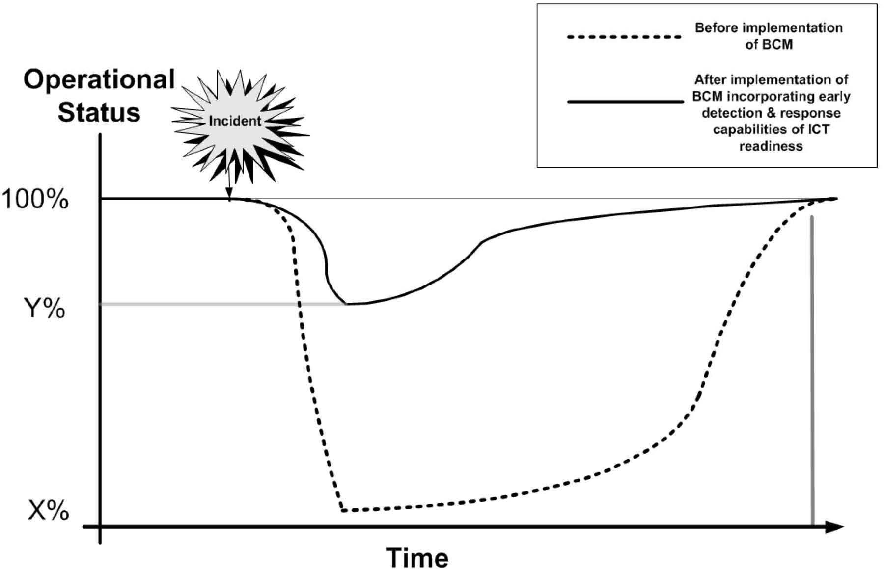
Effect of BCM
35

Slide 36
How common is BCM in ‘the real world’?
2006 CCSS extract: Most commonly reported categories of computer security policies and procedures 2006 (2005, 2004):
Media backup procedures - 95% (96%, 95%)
User access management - 93% (97%, 94%)
External network access control procedures - 78% (83%, 79%)
Documented operating procedures - 76% (80%, 83%)
User responsibilities policies - 72% (82%, 78%)
Controls against malicious software - 66% (75%, 72%)
Monitoring system access and use - 64% (72%, 68%)
Change control procedures - 60% (82%, 75%)
Clock synchronisation policy – 59% (59%, 43%)
Decommissioning equipment procedures – 59% (65%, 40%)
System audit policy – 58% (71%, 58%)
– Business continuity management – 54% (73%, 58%)
– Incident management procedures - 51% (67%, 64%)
36

Slide 37
Business continuity management
The range of incidents and disasters to be considered include:
Acts of nature, for example:
Excessive weather conditions
Earthquake
Flood
Fire
Human acts (inadvertent or deliberate), for example:
Hacker activity
Mistakes by operating staff
Theft
Fraud
Vandalism
Terrorism
37

Slide 38


Business Continuity Plan (BCP)
From:
Getting control over the crisis
The business continuity plan describes:
a sequence of actions
and the parties responsible for carrying them out
in response to disasters
in order to restore normal business operations as quickly as possible
To:
Back in business
38

Slide 39
BCP Terminology
Business Continuity Plan
Plan for restoring normal business functions after disruption
Business Contingency Plan
Same as Business Continuity Plan
Contingency means ”something unpredictable that can happen”
Disaster Recovery
Reestablishment of business functions after a disaster, possibly in
temporary facilities
Requires a BCP
Business Continuity Management
Denotes the management of Business Continuity
Includes the establishment of a BCP
Information and communication technology (ICT) Readiness for Business Continuity (IRBC) (term used in ISO27031)
39

Slide 40
BCP Management (same as IRBC)
BCP Policy
Mgmt approval
Scope
Responsibility
Teams
Business Impact Analysis (BIA)
Critical functions
MTD
Risks
Identify Preventive Controls
Implement controls
Mitigate risks
Recovery Strategies
Processes
Facilities
Data
Develop BCP
Document:
Responsibility
Teams
Strategies
Test BCP
Exercises
Improvements
Training
Maintain BCP
Integrate
Update
Distribute
Source: NIST Special Publication 800-34 rev.1
Contingency Planning Guide for Information Technology Systems (p.13)
40

Slide 41





Supporting Information
BIA
POC lists
Procedures
Activation and Notification Phase
Activation criteria
Notification procedures
Outage assessment
Recovery Phase
Sequence recovery activities
Recovery procedures
Escalation and notifications
BCP Development
Incorporate BIA findings
Document recovery strategy
Reconstitution Phase
Concurrent processing
Testing
Notifications
Cleanup
Offsite data storage
Backup
Documentation
Appendices
BIA
POC lists
Procedures
BCP Development and Output: NIST SP800-34, rev.1 p.34
41

Slide 42
BIA: Business Impact Analysis
A Business Impact Analysis (BIA) is performed as part of the BCP development to identify the functions that in the event of a disaster or disruption, would cause the greatest financial or operational loss.
Consider e.g.:
IT network support
Data processing
Accounting
Software development
Payroll
Customer support Order entry Production scheduling Purchasing Communications
42

Slide 43
BIA (continued)
The MTD (Maximum Tolerable Downtime) is defined for
each function in the event of disaster.
Example:
Non-essential = 30 days
Normal = 7 days
Important = 72 hours
Urgent = 24 hours
Critical = minutes to hours
43

Slide 44
Alternative Sites
Redundant site
Mirror of the primary processing environment
Operable within minutes
Hot site
Fully configured hardware and software, but no data
Operable within hours
Cloud
Warm site
Partially configured with some equipment, but not the actual computers
Operable within days
Cold site
Basic electricity and plumbing
Operable within weeks
More
expensive
Less expensive
Whenever relevant, consider cloud services, which can be relatively low cost
44

Slide 45
BCP Testing
Checklist test
Copies of the BCP distributed to departments for review
Structured walk-through test
Representatives from each department come together to go through the plan
Simulation test
All staff in operational and support functions come together to practice executing the BCP
Parallel test
Business functions tested at alternative site
Full interruption test
Business functions at primary site halted, and migrated to alternative site in accordance with the BCP
45

Slide 46
End of Lecture
46

